Slide 1
Progress report
Tao Liu
2/25/2016

Slide 2

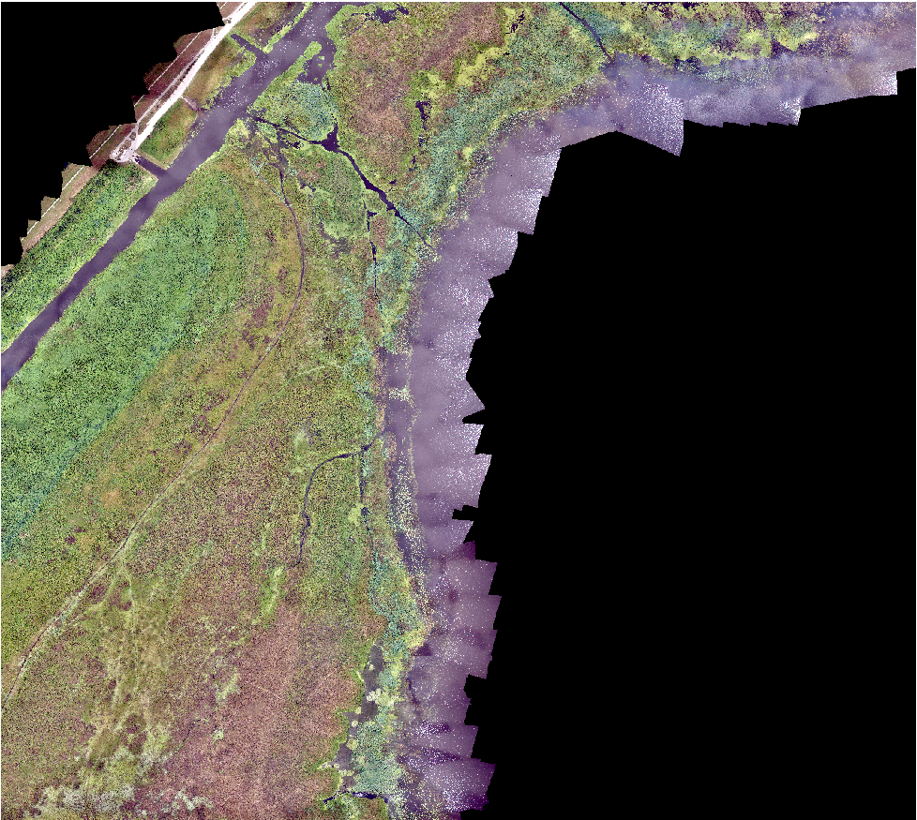


Algorithm input

Slide 3
One data item
Lettuce
X
Y
One data item

Slide 4
TRAIN, VALIDATION AND TEST
X
Y
X
Y
Testing 6667
X
Y
X
Y
Total
72546
Validation 6667
Shuffle
…………………….
…………………….
…………………….
…………………….
Training 59212
X
Y
X
Y

Slide 5
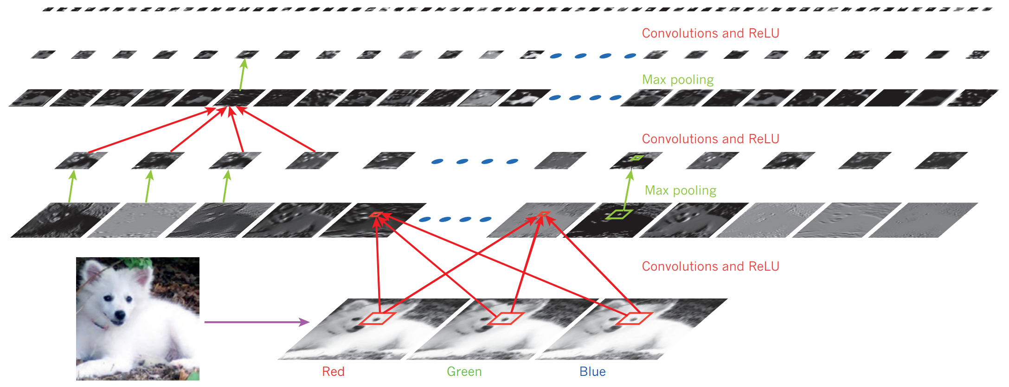
Model structure

Slide 6
Result
Epoch 0: validation accuracy 55.63%
This is the best validation accuracy to date.
The corresponding test accuracy is 54.83%
Epoch 1: validation accuracy 61.50%
This is the best validation accuracy to date.
The corresponding test accuracy is 60.09%
………………….
………………….
Training mini-batch number 351000
Training mini-batch number 352000
Training mini-batch number 353000
Training mini-batch number 354000
Training mini-batch number 355000
Epoch 59: validation accuracy 85.38%
Finished training network.
Best validation accuracy of 86.29% obtained at iteration 301970
Corresponding test accuracy of 85.71%

